Slide 1

System:
Online Shopping

Slide 2
Scenario
A customer should be able to contact with the system to order anything he want.
The system check if the target order is available from the warehouse. The warehouse reply confirmation order.
A customer must be able to make a cash withdrawal from any suitable account linked to the card. Approval must be obtained from the bank before cash is dispensed.
An administrator manage products and sales details, In addition to Create and Update categories. He get a reports from system with all sales that sold or it’s statistics.
The visitor just want to browse all products , or know about our offers.
The shipping agent asks a place of shipment from system. The shipment agent respond to customer with the order data which will delivered.

Slide 3
Discussion
Abstract :
online shopping system is seen as a form of electronic commerce which allows customers to directly buy goods or services from the seller Via Internet using a web browser
Problems :
If system break down , the order will not deliver to customer which lose the confidence of their customers
Security issues if it had Hacked from any attackers will causes a bad reputation for the organization

Slide 4
Discussion
Objectives :
Well-built System provide to customer buy any services online around the world at his place and enables visitors to search and browse things as they want
Scape :
Not dependant on any place, it’s Online service
Users :
Any customers or clients can use this system
Context Diagram :

Slide 5
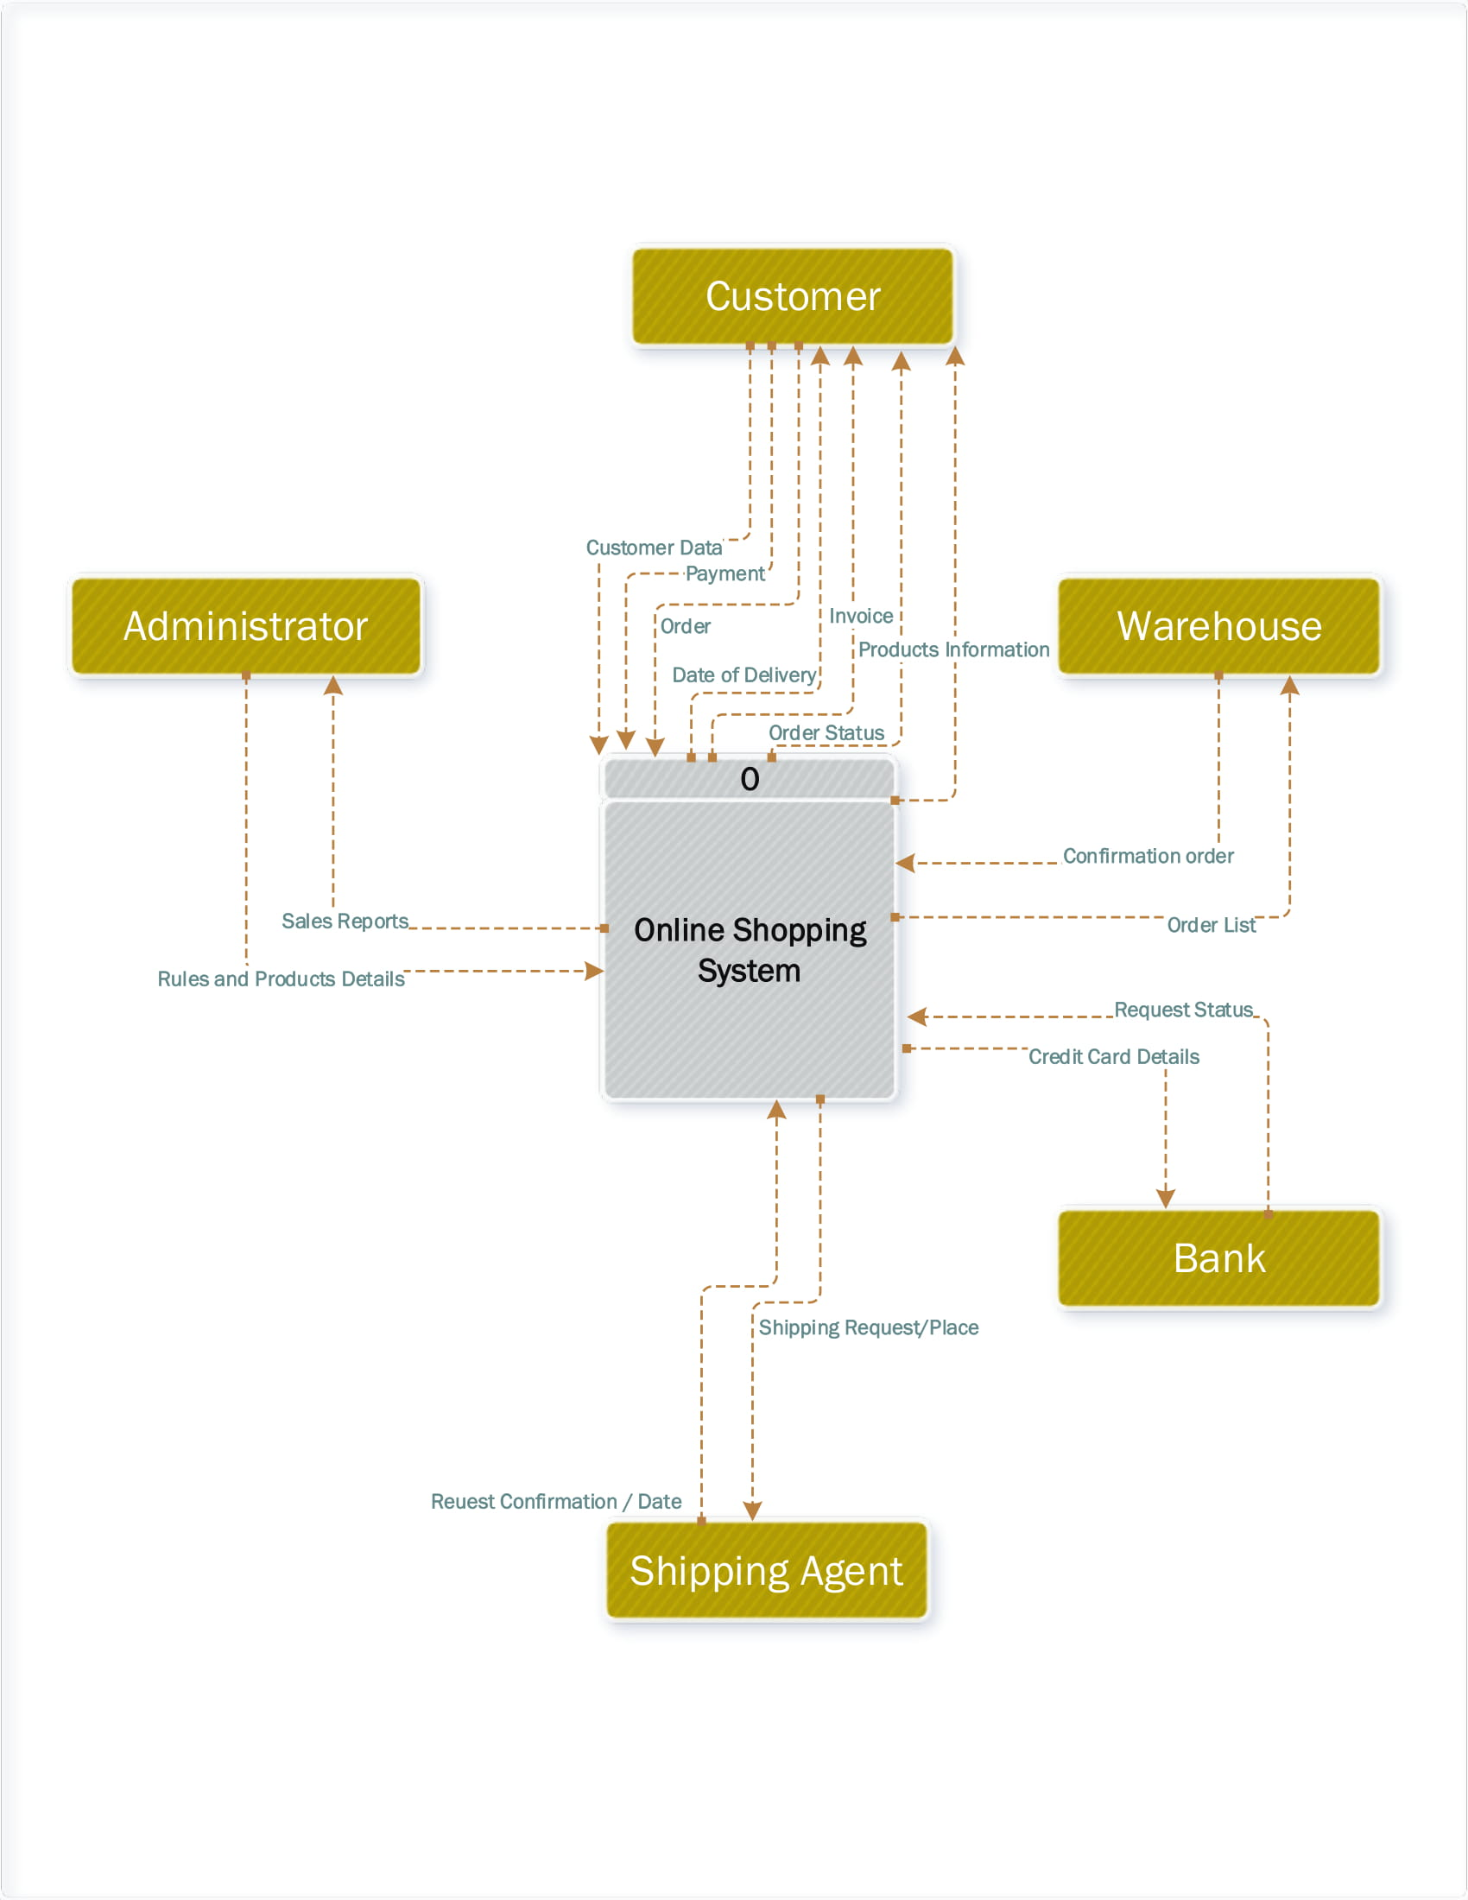

Slide 6
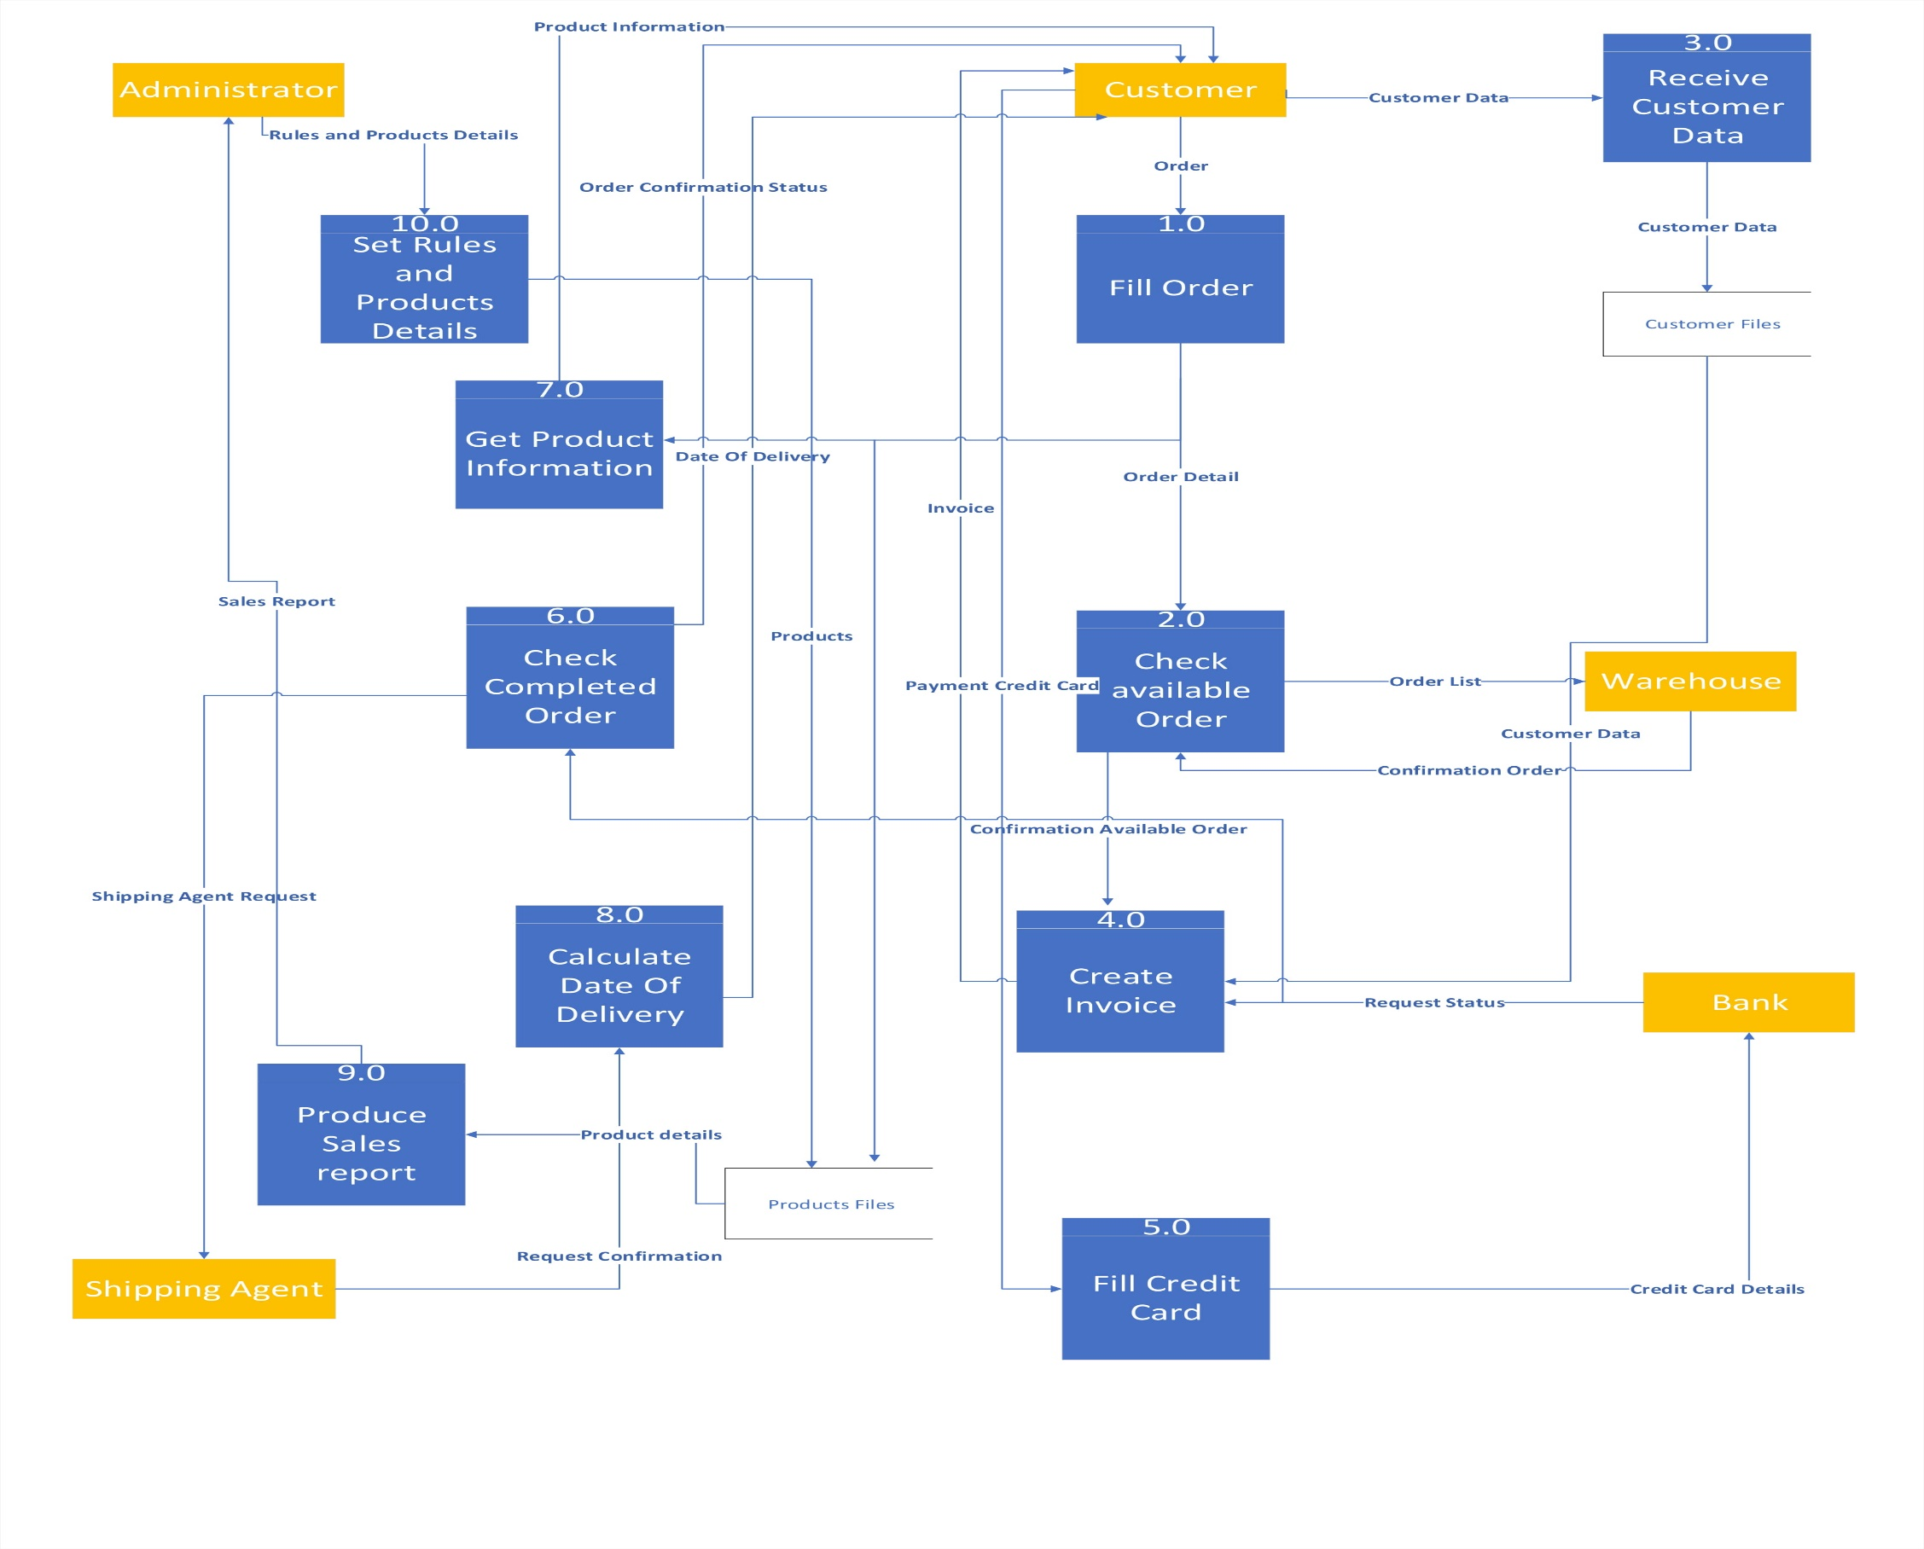

Slide 7
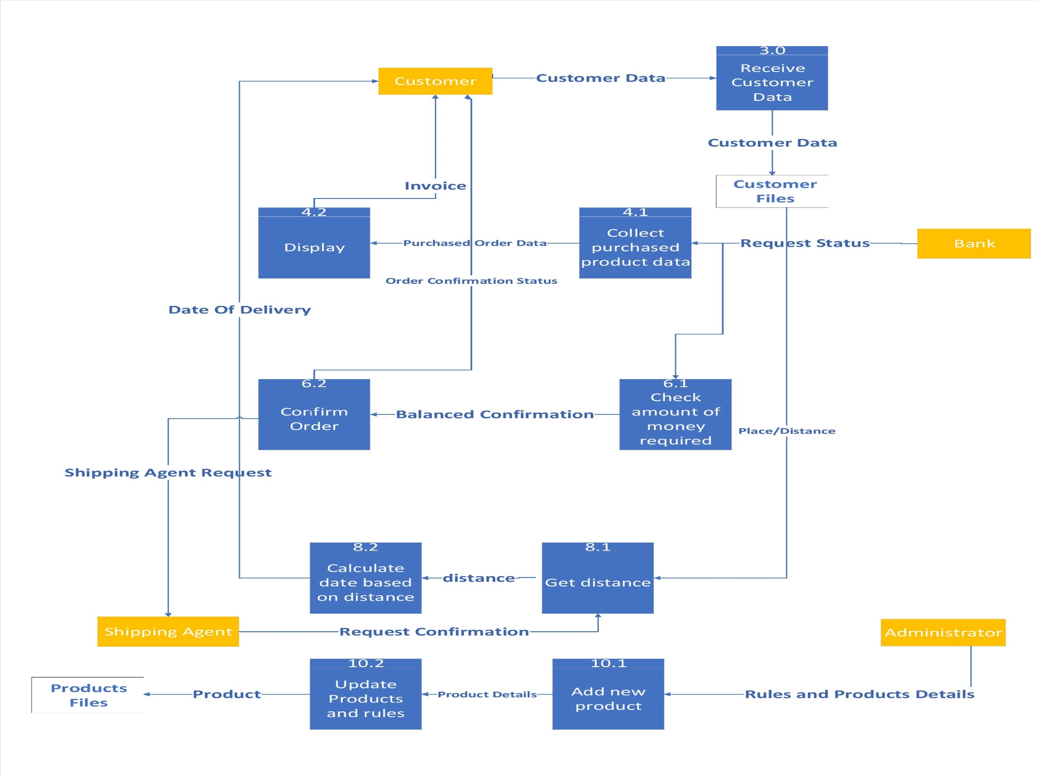

Slide 8
